Slide 1
Transforming a National
Education System
A case study by return(F)

Slide 2
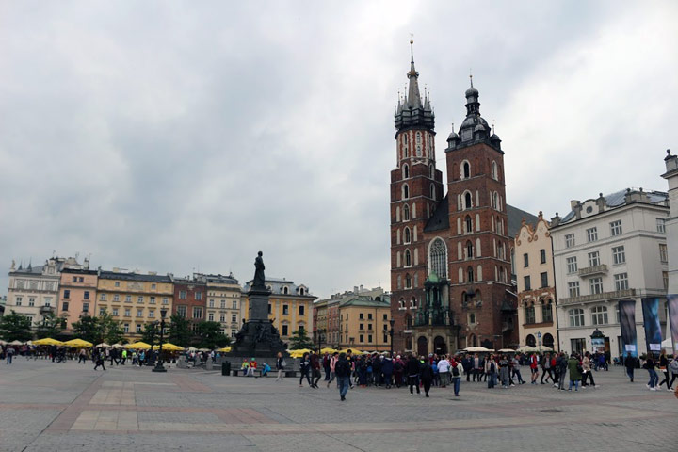
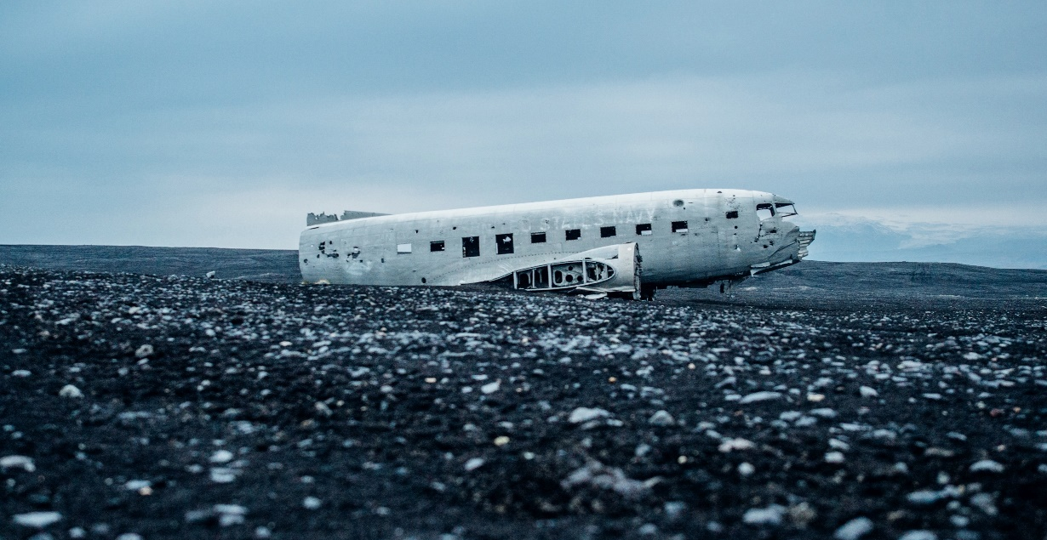
Introduction
The free market economy of Loravia continues to develop, evolving from communism over many decades. The Loravian Government recently implemented a new economic plan with a goal to change its economy in order to make it "turbocharged" to compete with its European neighbours. The Loravian Government recognizes that its children's education is a key factor in the achievement of its economic development objectives. In the coming 10 years it plans to transform its school system so that its economic aspirations can be supported.
Loravian schools are fully public and are provided to children aged 5 to 18 by a network of government-run schools.
The first stage of this initiative is to assess the current education situation in schools in Loravia and figure out how the potential goals of the government can best be accomplished.

Slide 3
AGENDA
01
Issue Identification
What are the issues you would want to investigate in diagnosing the condition of the current school system in Loravia?
02
Comparison & Observation
Comparison of Loravia with similar sized economies and EU counterparts.
03
Reduction in Schools
What would be the reduction in the total number of schools in Loravia if it were to reach the same average school size as neighbor country C?
04
Further Investigation
Based on the issues and information discussed so far, what further issues would you want to investigate as part of the diagnostic of the current education system in Loravia?

Slide 4
01. ISSUE IDENTIFICATION: IDENTIFYING WHAT FACTORS AFFECT EDUCATION
What are the issues you would want to investigate in diagnosing the condition of the current school system in Loravia?
Access to Education
Ease of availability of educational institutions to people of different regions and communities
Healthcare System
Existence of a robust healthcare system
Technological Advancement
Accessibility of technological tools and know-hows
Education curriculum and structure
Quality of education and the structure of educational institutions
Quantity and Quality of Teachers
Government Spending
Number of teachers and their education qualifications
Allocation of funds for the education sector
Individual Poverty
Inability to financially support education

Slide 5
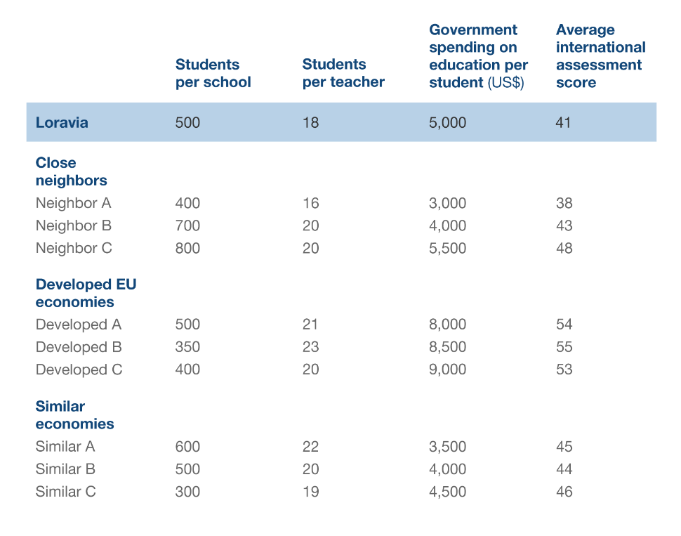
2. COMPARISON & OBSERVATION
The following chart shows some major educational measures for Loravia and some countries of comparison. There have been three collections of comparable countries. Some of Loravia's eastern European neighbors are in the first collection. Some of the more advanced economies in Europe are in the second set. The third group includes countries which have economies of similar size per person (similar per capita GDP) to those of Loravia.

Slide 6
Infographic Style
INSIGHTS:
In comparison with its economic counterparts and the neighbouring nation, Lovaria has higher per student spending on education.
Developed EU counterparts spend more per student on education. They also have a higher international assessment score.
The student/teacher ratio is comparatively lower for Lovaria in comparison with its neighbours and economic counterparts.
The difference in number of students per school may be indicative of the various demographic and population factors.
Lovaria has one of the lowest international assessment score despite having a comparatively higher spending per person on education and a lower student/teacher ratio to its neighbours and economic counterparts.
Since student/teacher ratio is not a very good measure of education standard, therefore more importance must be given to the curriculum structure and quality of education.
It can be concluded, that there is no apparent co-relation between spending per person on education, student/teacher and international assessment scores
International assessment marks may not be the best measure of the standard and quality of education.

Slide 7
03. REDUCTION IN SCHOOL
THE PREMISE:
One of the clients at the Loravian Department of Education mentions the example of neighbor country C, which outperforms all of Loravia's economic peers and neighbors in the international assessment. She believes that the more concentrated school structure in this country is a big reason for its better outcomes in the international assessment. She suggests that having larger, less fragmented schools allows for more effective selection and training of teachers, leading to improved education outcomes for the students.
GIVEN INFO:
15 percent of Loravia's population are currently attending school.
PROBLEM STATEMENT:
What would be the reduction in the total number of schools in Loravia if it were to reach the same average school size as neighbor country C?

Slide 8

SOLUTION
Population of Loravia (Pl) 20 Millions
Percent of Population in school(Ps): 15%
Students per School Loravia (Ss)= 500
Students per School Neighbour C (Sc)= 800
Number of School Students (N)
Ns = Pl x Ps = 3 million students
01
Number of School Closed (N’’)
Number of Schools in Loravia (N’)
02
04
N’’= N’ – Nc = 2250 schools
N’= (N)/(Ss)= 6000 schools
Number of School Closed =2250
03
Number of school neighbor C will give in Loravia (Nc)
Nc=(Ns)/(Sc)= 3750 schools

Slide 9
School Reduction Analysis
The reduction in the total number of schools in Loravia if it were to reach the same average school size as neighbor country C is 2250
Pragmatically reducing the number of schools in Loravia is not possible. The reduction will result in re-allocation of students as well as teachers.
Therefore, the re-allocation of the educational structures, on the contrary, can be counter-productive, and is not a pragmatic approach.

Slide 10
FURTHER INVESTIGATION
Student/Teacher Ratio:
Further investigation required to find the impact of a better student/teacher ratio (quantitative) since it not completely indicative of the standard of education.
01
Government Spending:
Higher government funding does not necessarily increase the quality of education, as we encountered in the case of Loravia. Therefore, further investigation is required.
02
Quality Measure:
Further investigation required in to the qualitative measures such as curriculum structure, quality of teaching, etc. Lack of these can be the cause of underperforming education sector of Loravia.
03

Slide 11
SWOT Analysis
THREATS
STRENGTHS
Better education opportunities in economically well off countries can lead to ‘brain-drain’
Currently has a free market economy, which can attract foreign investments, eventually having a trickle down effect on education sector.
S
T
W
O
OPPORTUNITIES
WEAKNESS
Multiples sector will eventually benefit from the flourishing education sector.
Still recovering from the lingering affects of communism in the economy

Slide 12
CONCLUSION
Loravia is a small economy having a free market. The population of school going children is 15% of the total population. It has many underlying opportunities as well as areas for improvement in the school education sector. Following is our suggested solution to how best meet the current education needs of Loravia.
Identification and removal of the contemprory
Issues, like lack of proper infrastructure, difficulty in accessibility.
Not relying solely on the quantitative measures. Government funding and student/teavher ratio is important, but not absolute.
Focusing on the qualitative measures such as the curriculum structure, the quality of education imparted, presence of a collabarative environment etc. is more important
Updation and implantation of new technology and communication system to ease the access of education. Oberving trends in the data, and try to make useful inference.

